Slide 1
Selling products / services to consumers is a critical element of any on-line retail strategy
Strategies
Theme/Concept
Example
Expanding Product / Service Offer
Offering a broader array of goods and services to choose from that may not be available from traditional retailers
Wal-Mart
cosmeticscounter.com
Amazon.com
Extending Markets / Customer Base
Expanding a merchant’s trading area to areas which were not accessible before (or which were not cost effective to serve)
Macy*s
Cyberian Outpost
HotHotHot.com
Mass Customization
Allowing customers to customize products to their specifications and/or interests, which will increase customer satisfaction and also assist merchants in future configurations
Levi Strauss
Dell Computers
BMW
Expanded Purchasing Options
Offering automatic re-order mechanisms to consumers on items that need to be restocked, increasing both sales and creating higher switching costs
Providing inbound and outbound gift registries, letting customers select gifts for himself / herself or for others, and also purchase from others’ registries, with the confidence that the gift will be desired, and unique.
Streamline.com
NetGrocer.com
Cosmeticscounter
Macy*s
The Knot
Clinique
Product Development / Testing
Utilizing on-line customer interest and sales information to determine which products to market and how to market them. Similar information can be used to drive product development, and new products can be tested on-line without the investment of a full-scale rollout
Levi’s
Close-out / Inventory Management
Facilitating sales of closeout goods by offering them to a wider audience, and improving margins / turnover by lowering overall selling costs and improving throughput
Lands’ End
dELiA*s
J. Crew

Slide 2
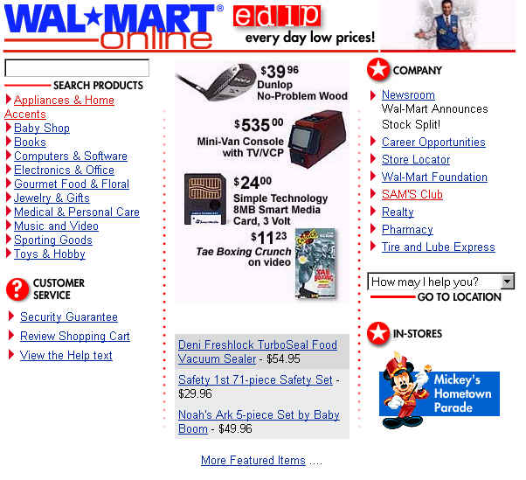
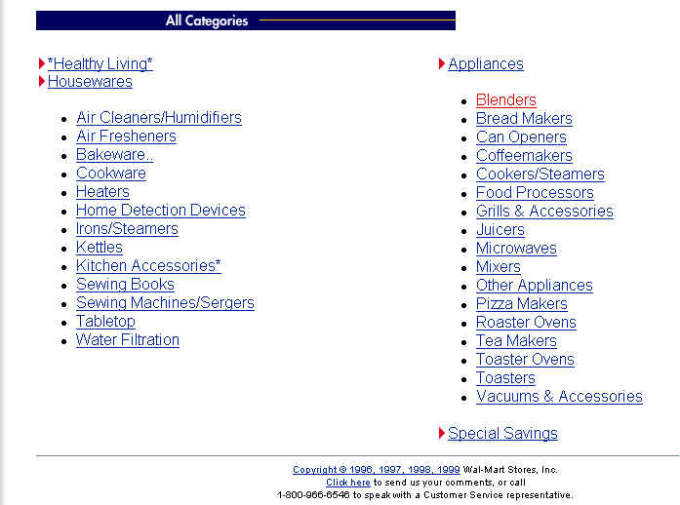
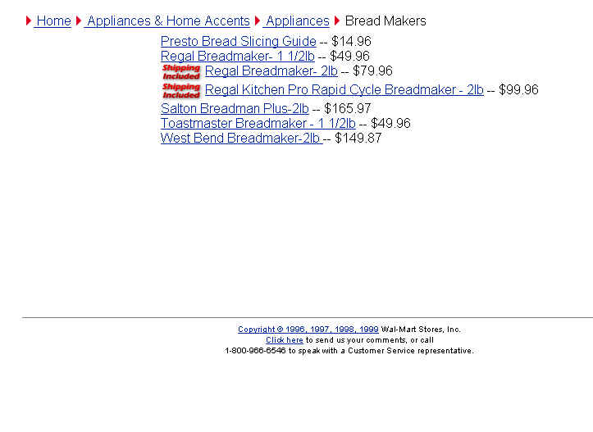
E-Biz Opportunity: Selling Products/Services; Expanding Product/Service Offer
Website example: www.wal-mart.com
URL: http://www.wal-mart.com/
Search for item directly using the search function
Or browse by selecting the appropriate category (ex. Appliances)
Select product desired (ex. Bread Makers)
Not all of these Bread Makers are offered offline. Wal-mart carries 175,000 - 250,000 items online at any given time, while it only carries 80,000 - 100,000 items in it’s stores and supercenters.

Slide 3
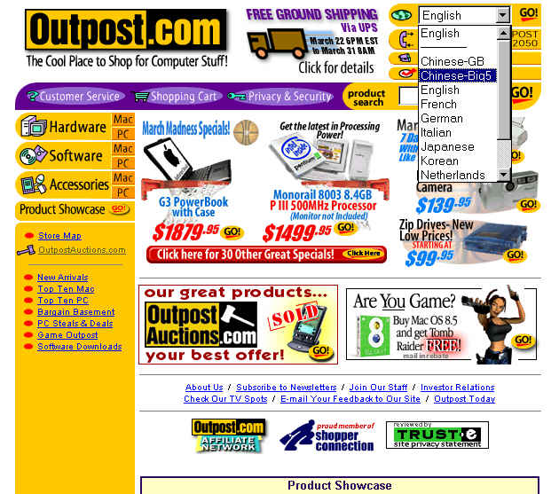
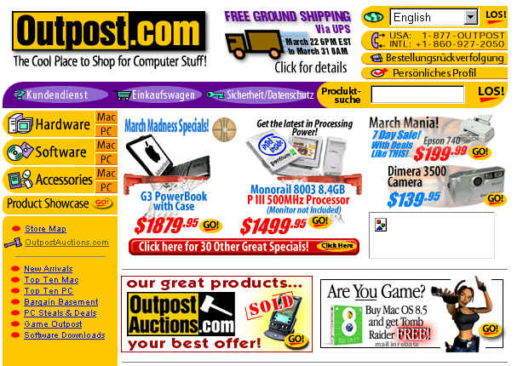
E-Biz Opportunity: Selling Products/Services; Extending Markets/Customer Base
Website example: www.outpost.com
URL: http://web4.ops.outpost.com/cgi-bin/bv.cgi
Pull down menu allows the consumer to select the language the interface is displayed (ex. German)
Navigation buttons are now in German. The site would better if all of the text was in German and not just the navigation buttons.
Both US number and Int’l number are listed.

Slide 4
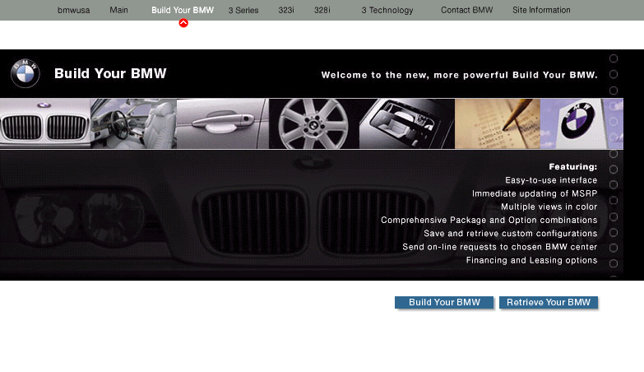
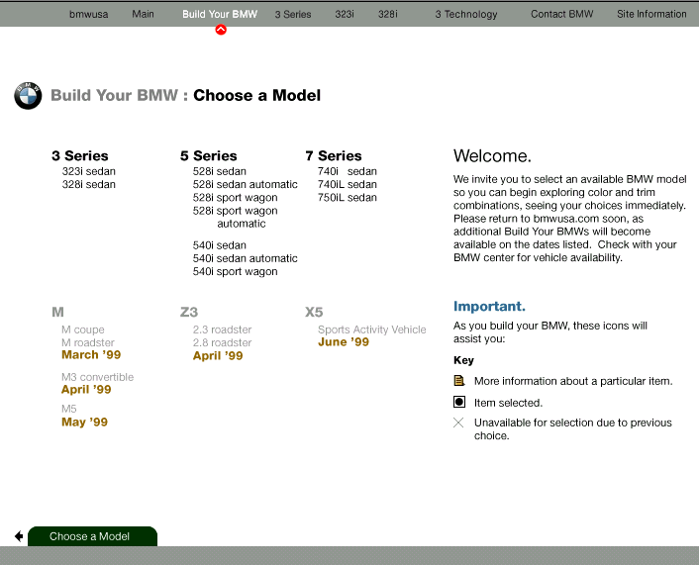
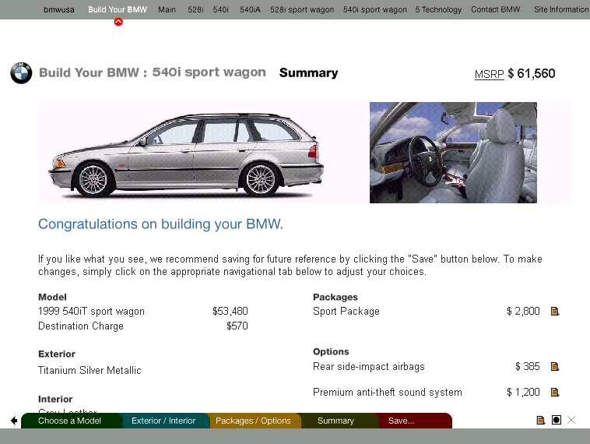
E-Biz Opportunity: Selling Products/Services; Mass Customization
Website example: http://build.bmwusa.com
URL: http://build.bmwusa.com/yourbmw/start3.html
Summary page shows the package/options selected and the price of the customized vehicle.
Price of the customized vehicle
Clear navigation button allows consumer to either build a customized BMW or to retrieve a saved profile already created.
A key to show what the symbols mean
“Choose a Model” tab
Options selected for the customized vehicle

Slide 5
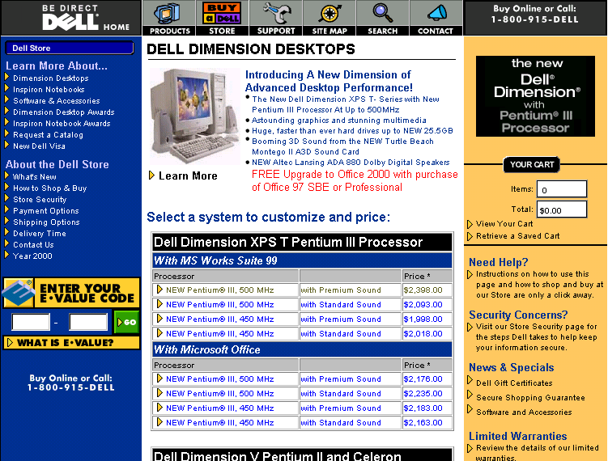
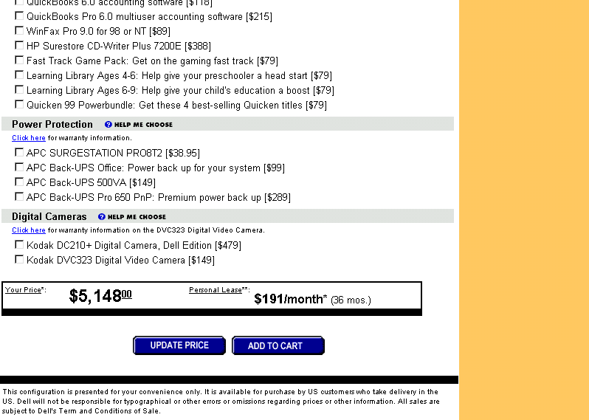
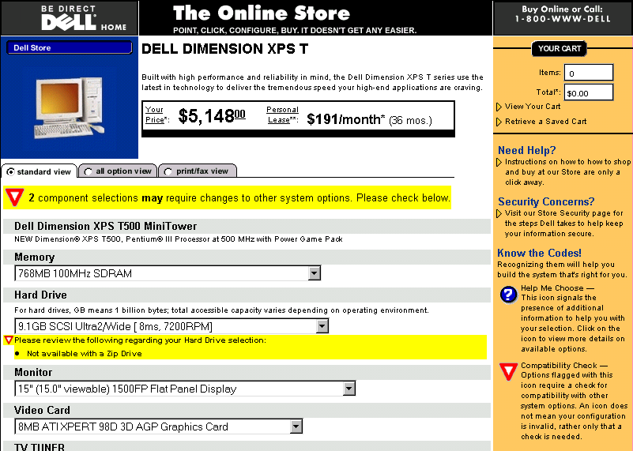
E-Biz Opportunity: Selling Products/Services; Mass Customization
Website example: http://www.dell.com
URL:http://commerce.us.dell.com/welcome/minicat.asp?brand_id=DIM&customer_id=19
Price of the customized package
Personal Lease
Select a system to customize
Update Price button allows the consumer to see the price after the upgrades/ additions
Shows the options/upgrades selected

Slide 6
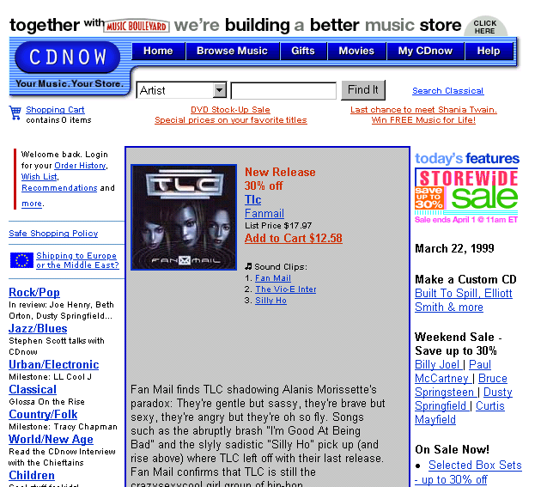
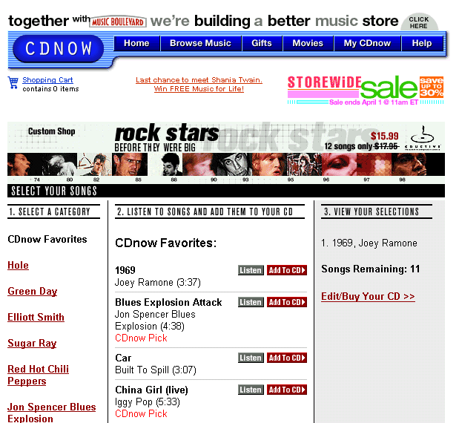
E-Biz Opportunity: Selling Products/Services; Mass Customization
Website example: www.cdnow.com
URL:
Customize CC option
Shows the songs already selected to be in the customized CD.
Option to listen before adding song to CD
Shows the number of songs remaining in the CD
Clear “Add to CD” option
After adding the songs, the consumer has the option to change selections and/or buy the customized CD.

Slide 7
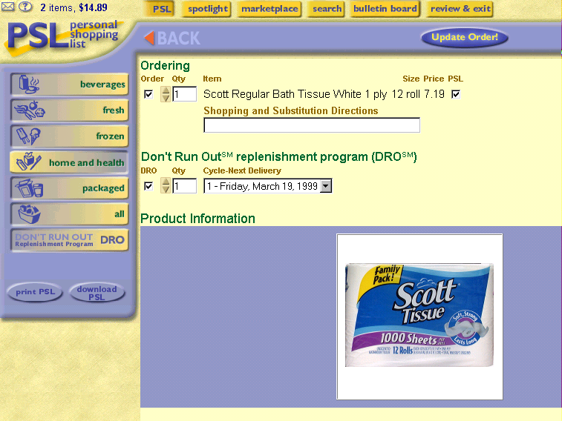
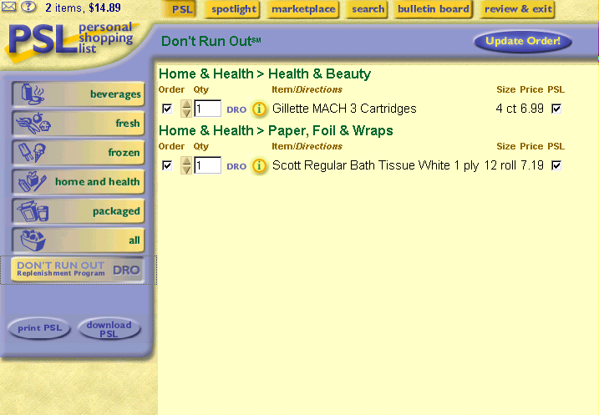
E-Biz Opportunity: Selling Products and Services; Expanded Purchasing Options
Website example: www.streamline.com
URL: http://www.streamline.com/super.asp
DRO page shows the items that the consumer has selected to be automatically re-ordered.
Replenishment Cycle
DRO icon shows the product is in the Don’t Run Out Program
Don’t Run Out Program set up for auto-reorder

Slide 8
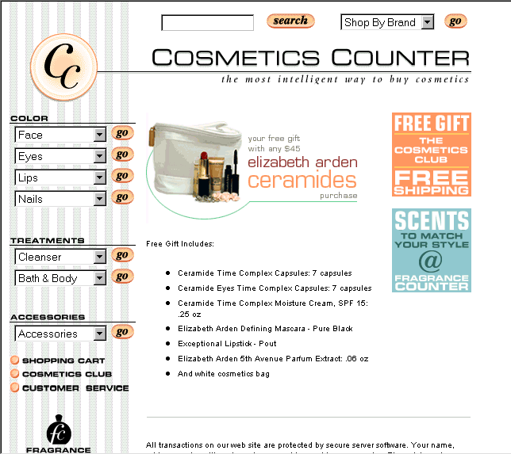
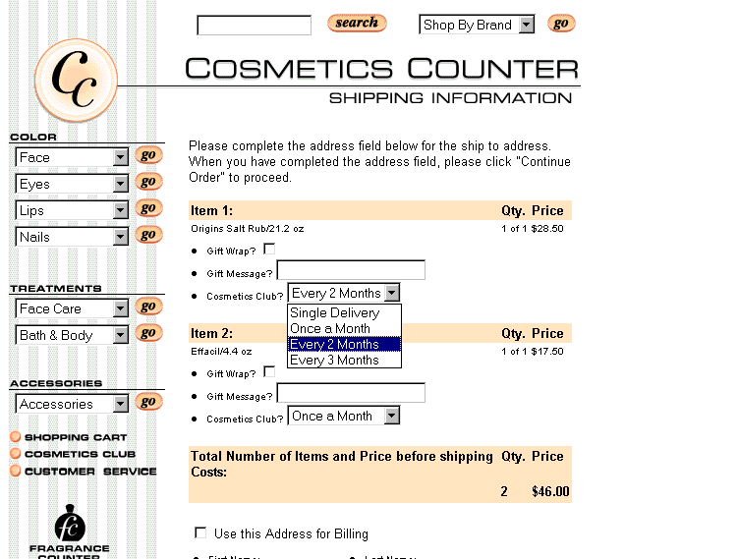
E-Biz Opportunity: Selling Products and Services; Expanded Purchasing Options
Website example: www.cosmeticscounter.com
URL:https://www.cosmeticscounter.com/checkout/shipping_single.jtmpl?borschtid=209.143.245.228:80:99152008791225006024
Replenishment Cycle
Cosmetics Club allows consumers to have selected items to be automatically re-ordered.

Slide 9
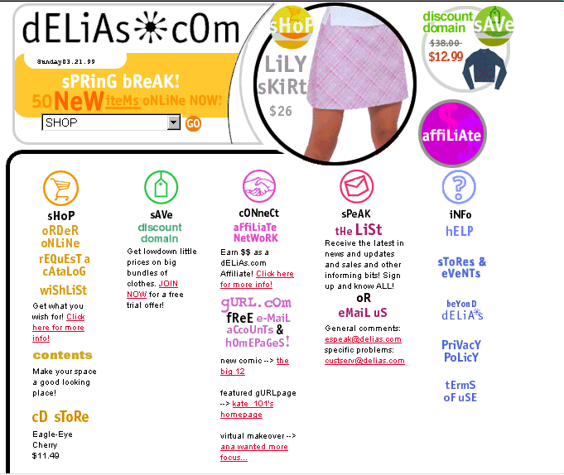
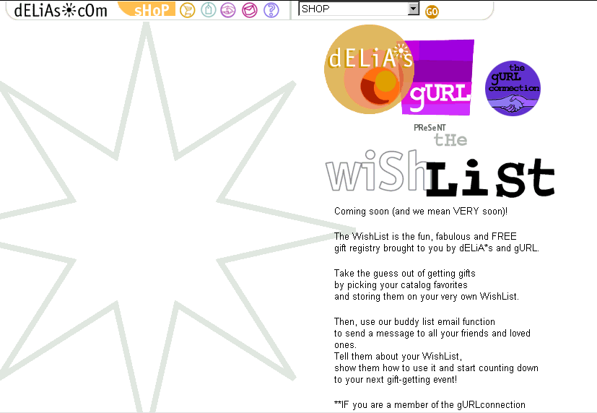
E-Biz Opportunity: Selling Products and Services; Expanded Purchasing Options
Website example: http://www.delias.com
URL:http://connection.gurl.com/giftregistry/index.html
Wishlist option
Wishlist description

Slide 10
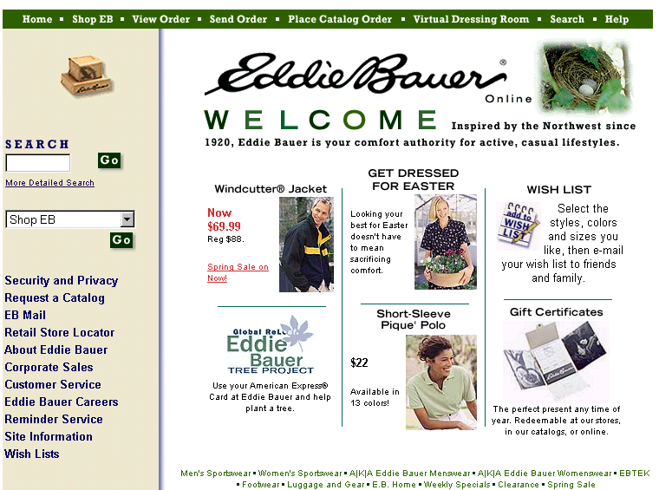
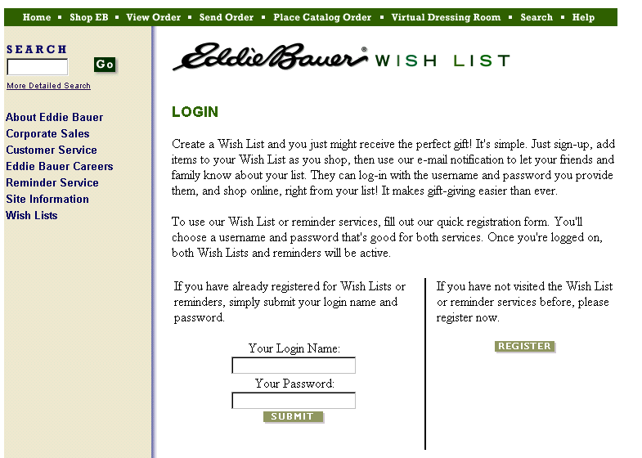
E-Biz Opportunity: Selling Products and Services; Expanded Purchasing Options
Website example: www.eddiebauer.com
URL:http://www.eddiebauer.com/member_registration/frame_wishlist_login.asp?from=wishlist%2Fframe%5Fwishlist%2Easp
Wishlist option
For those that have not signed-up, they can register.
Login for consumers already signed up for the service

Slide 11
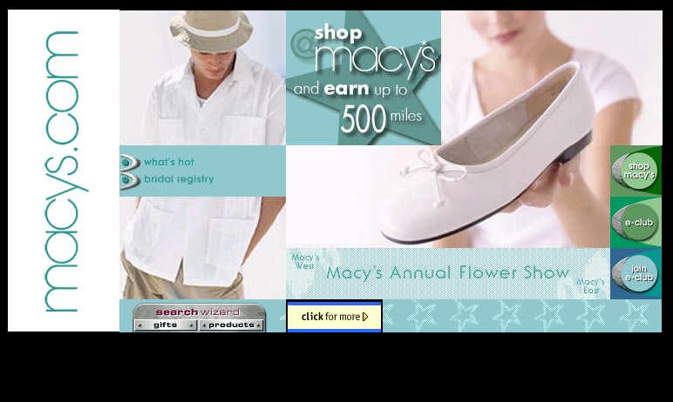
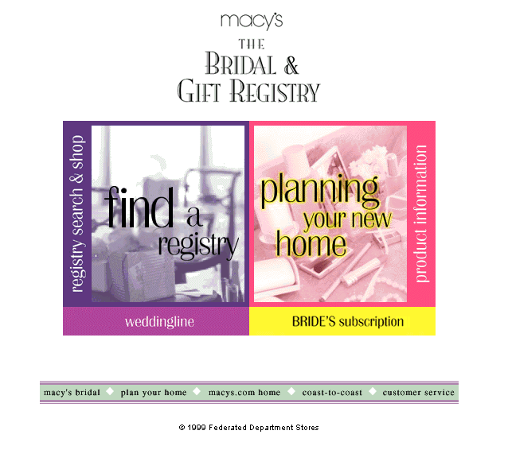
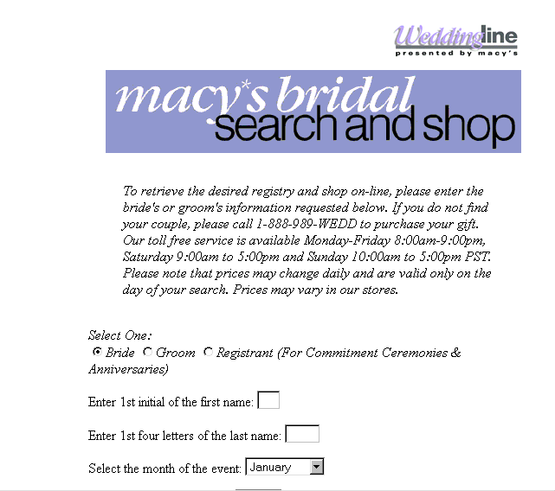
E-Biz Opportunity: Selling Products and Services; Expanded Purchasing Options
Website example: http://www.macys.com
URL:http://www.macysbridal.com/
Clear navigation to enter the Bridal registry from Macy’s homepage.
Search to find the registered party.
Registry Search & Shop

Slide 12
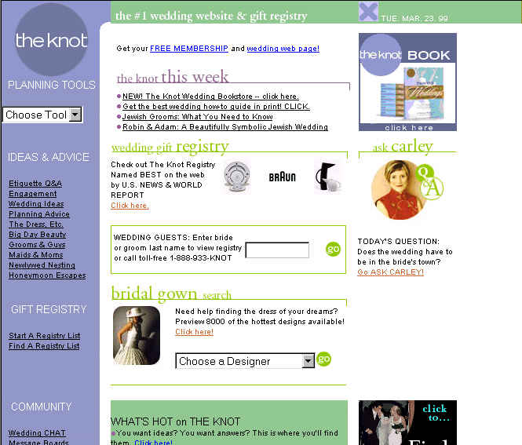
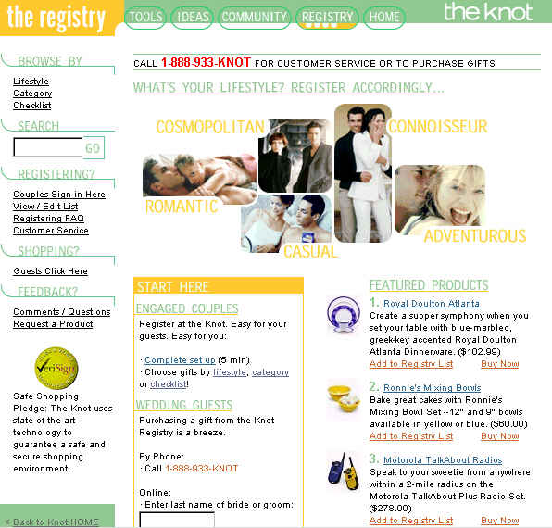
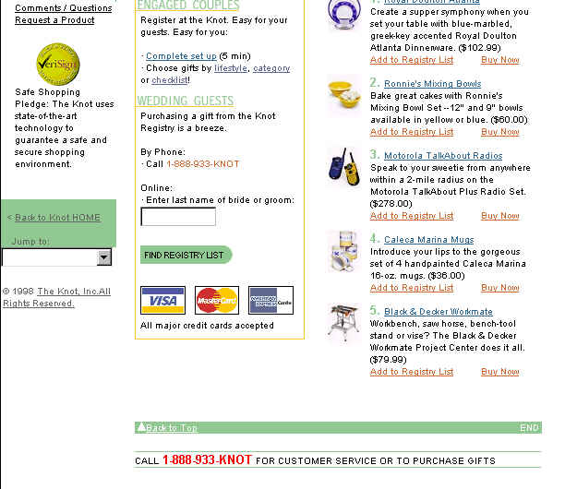
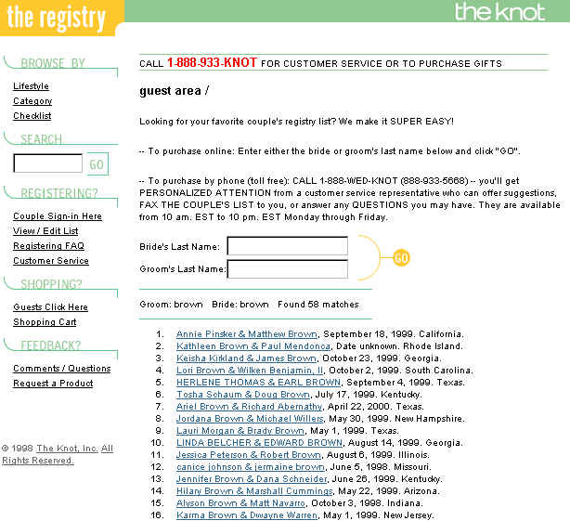
E-Biz Opportunity: Selling Products and Services; Expanded Purchasing Options
Website example: http://www.theknot.com
URL:http://www7.theknot.com/registry.html
Bride/Groom Search
Hotline number is also listed.
Registry option to start a registry list(for brides and grooms) or to find a registry (for guests).
Option to refine search
Last name Bride/Groom search (ex.Brown)
Last name Brown search results. Each entry is hot linked.

Slide 13
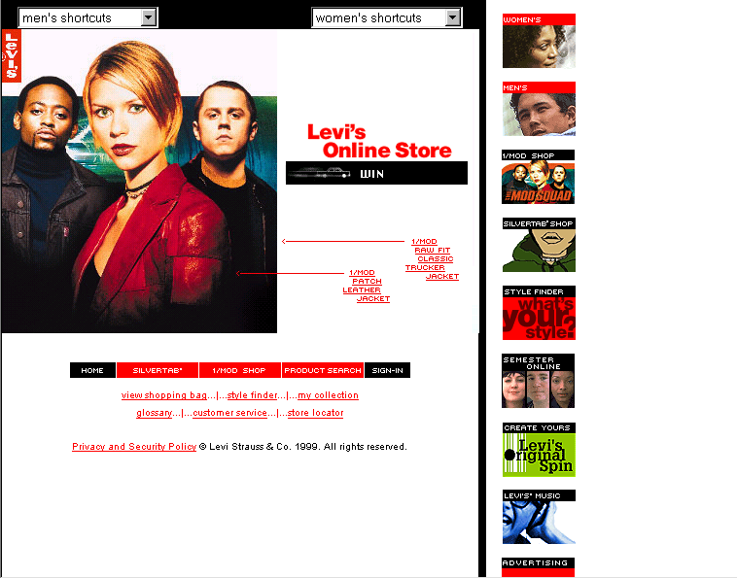
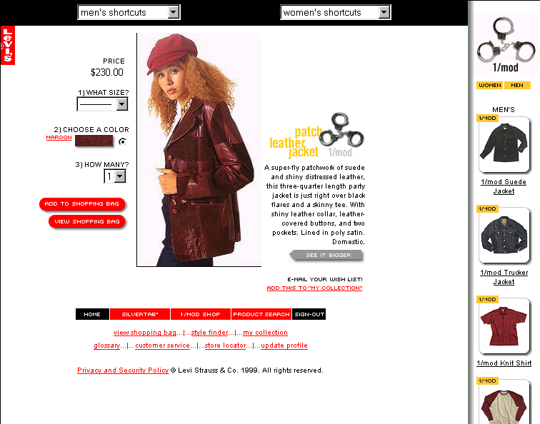
E-Biz Opportunity:Selling Products and Services; Product Development/Testing
Website example: www.levi.com
URL: http://store.us.levi.com/store/home.asp
1/Mod collection inspired by the Mod Squad movie.
Clothes worn by Claire Danes, Omar Epps, and Giovanni Ribisi can be purchased online starting 3/1/99. It will get retail distribution if the movie does well.
Shows the 1/mod line
Retro jacket is hot linked.
1/Mod Shop button

Slide 14
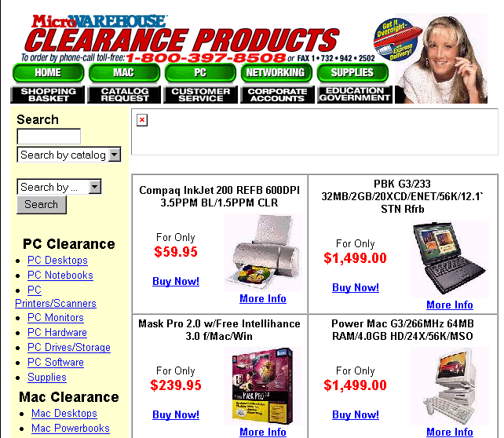
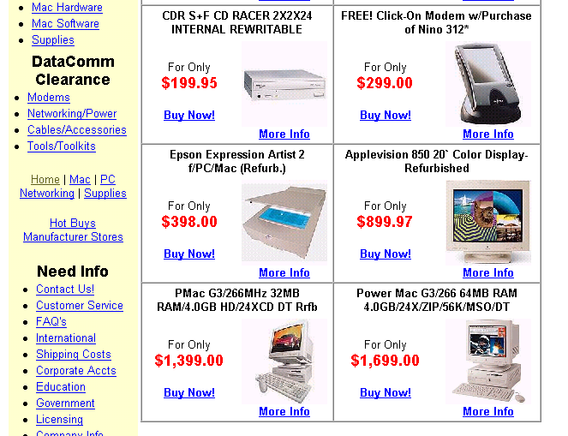
E-Biz Opportunity: Selling Products and Services; Close-out/ Inventory Management
Website example: www.microwarehouse.com
URL:http://product.warehouse.com/search/BIN/SEARCHINTERFACE.DLL?OrderBy=3&num_rows=25&value=clz&result_template=clear.tem
Clearance Products
Clearance Items by Category
Clearance items w/ photo and price

Slide 15
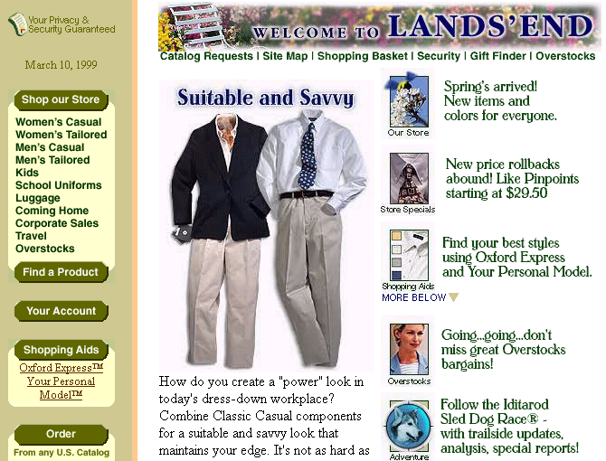
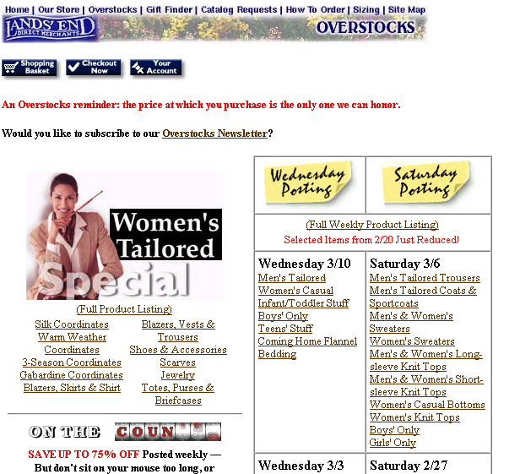
E-Biz Opportunity: Selling Products and Services; Close-out/ Inventory Management
Website example: www.landsend.com
URL: http://www.landsend.com/spawn.cgi?NODEOVER0396&GRAPHIC&ZEROPAGE&0920593653078
Email Reminder
Weekly Product Listings
Price Reductions
Overstock listed on navigation bar

Slide 16
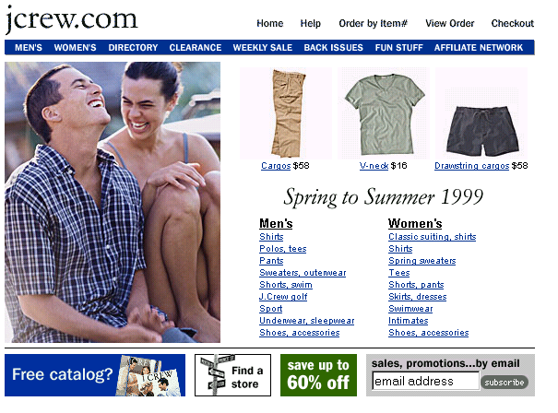
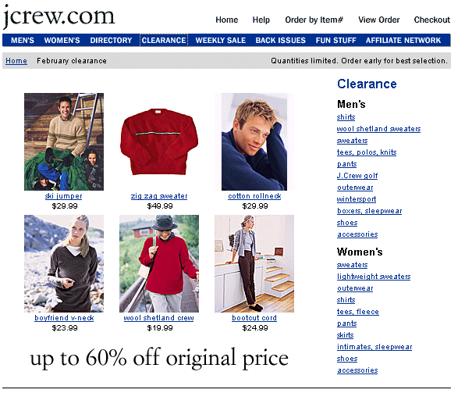
E-Biz Opportunity: Selling Products and Services; Close-out/ Inventory Management
Website example: www.jcrew.com
URL:http://www.jcrew.com/cgi-bin/index.cgi
Clearance listed clearly on the navigation bar.
Clearance items by category
The % Off/ Saved

